Slide 1
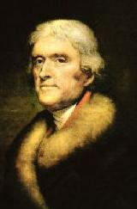
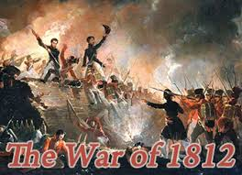
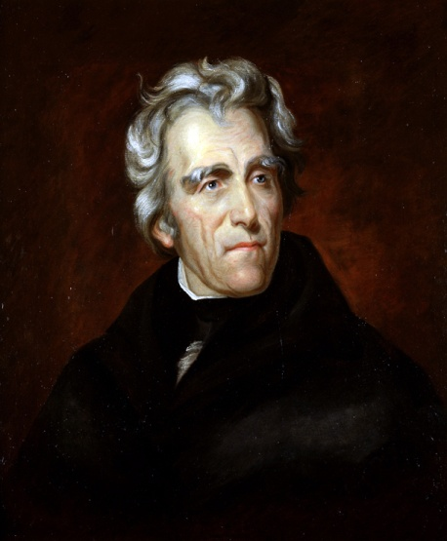
Period 4 1800-1848
In a nutshell:
The new republic struggled to define and extend democratic ideals in the face of rapid economic, territorial, and demographic changes.

Slide 2
Key Concepts
Part 1
A. The United States developed the world’s first modern mass democracy and celebrated a new national culture, while Americans sought to define the nation’s democratic ideals and to reform its institutions to match them

Slide 3
Key Concepts
B. The nation’s transformation to a more participatory democracy was accompanied by continued debates over federal power, the relationship between the federal government and the states, the authority of different branches of the federal government, and the rights and responsibilities of individual citizens.

Slide 4
Key Concepts
C. Concurrent with an increasing international exchange of goods and ideas, larger numbers of Americans began struggling with how to match democratic political ideals to political institutions and social realities.

Slide 5
Key Concepts
D. While Americans celebrated their nation’s progress toward a unified new national culture that blended Old World forms with New World ideas, various groups of the nation’s inhabitants developed distinctive cultures of their own.

Slide 6
Key Concepts
Part 2
E. Developments in technology, agriculture, and commerce precipitated profound changes in U.S. settlement patterns, regional identities, gender and family relations, political power, and distribution of consumer goods

Slide 7
Key Concepts
F. A global market and communications revolution, influencing and influenced by technological innovations, led to dramatic shifts in the nature of agriculture and manufacturing.

Slide 8
Key Concepts
G. Regional economic specialization, especially the demands of cultivating southern cotton, shaped settlement patterns and the national and international economy

Slide 9
Key Concepts
H. The economic changes caused by the market revolution had significant effects on migration patterns, gender and family relations, and the distribution of political power

Slide 10
Key Concepts
Part 3
I. U.S. interest in increasing foreign trade, expanding its national borders, and isolating itself from European conflicts shaped the nation’s foreign policy and spurred government and private initiatives.

Slide 11
Key Concepts
J. Struggling to create an independent global presence, U.S. policymakers sought to dominate the North American continent and to promote its foreign trade.

Slide 12
Key Concepts
K. Various American groups and individuals initiated, championed, and/or resisted the expansion of territory and/or government powers.

Slide 13
Key Concepts
L. The American acquisition of lands in the West gave rise to a contest over the extension of slavery into the western territories as well as a series of attempts at national compromise.

Slide 14
Significant Topics
Development of American Political Parties
As various constituencies and interest groups coalesced and defined their agendas, various political parties, most significantly the Federalists and Democratic-Republicans in the 1790s and the Democrats and Whigs in the 1830s, were created or transformed to reflect and/or promote those agendas.

Slide 15
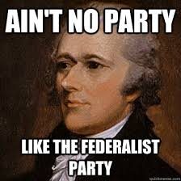
Federalists
Political party created in the 1790s.
Led by Alexander Hamilton, the Federalists favored a stronger national government.
Supported primarily by the bankers and moneyed interests.

Slide 16
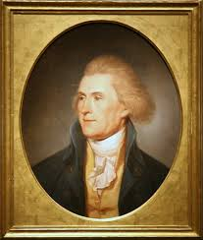
Democratic-Republicans
Political Party created in the 1790s.
Led by Thomas Jefferson
favored limited government and states rights.
Supported primarily by the “common man.”

Slide 17
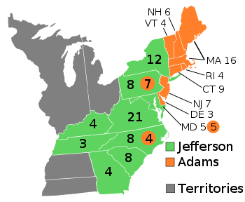
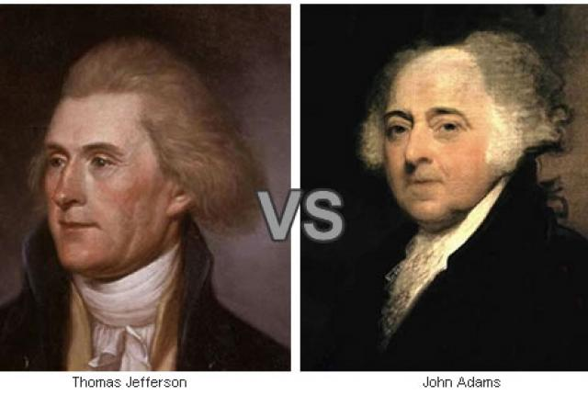
Election of 1800 aka (Revolution of 1800)
Election that led to a peaceful transfer of power from the Federalist Party to the Democratic-Republicans party.

Slide 18
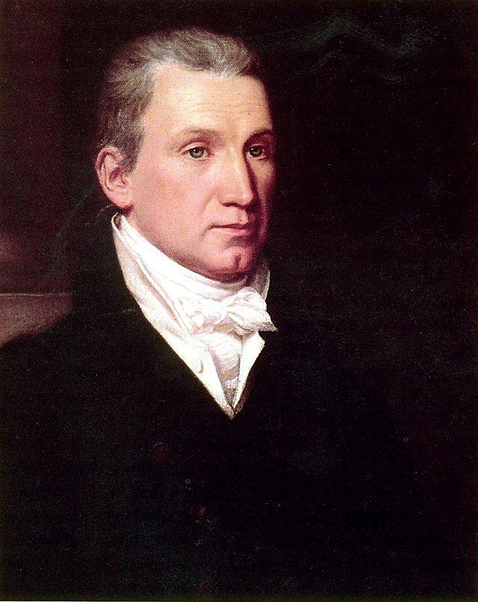
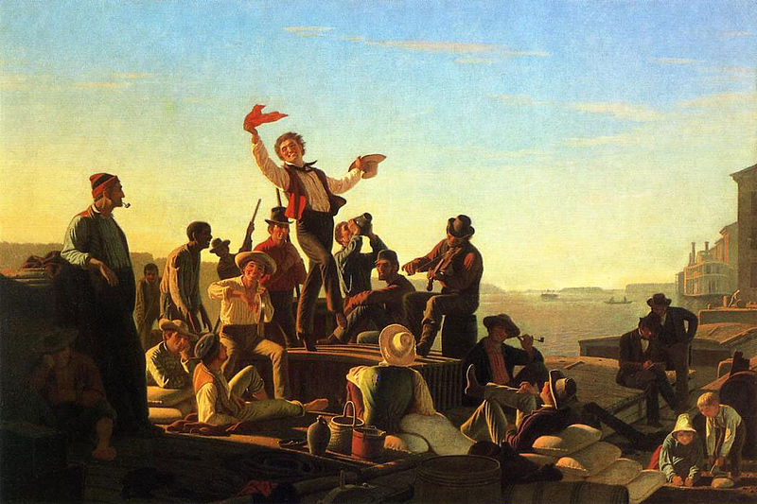
Era of Good Feelings
The period from 1816-1824
characterized by nationalism and one-party control of the nation.
The decline of the Federalist Party and the end of the War of 1812 gave rise to a time of political cooperation.
The Era of Good Feelings is associated with the presidency of James Monroe.

Slide 19
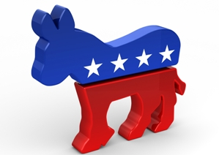
Democrats
Political party that brought Andrew Jackson into office in 1829.
Democrats supported Jeffersonian ideas of limited government, drawing its support from the “common man.”

Slide 20
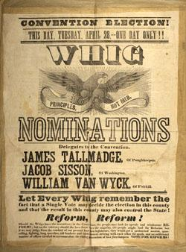
Whig Party
Political Party created in 1834 as a coalition of anti-Jackson political leaders.
supported the supremacy of Congress over the Presidency and favored a program of modernization and economic protectionism (tariffs)

Slide 21
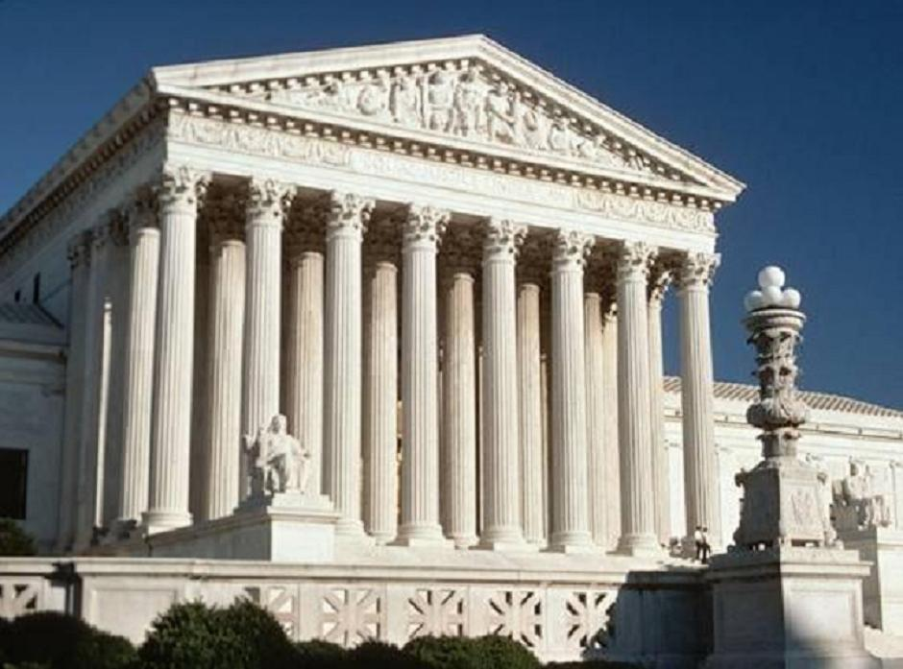
The Supreme Court, 1801-1835
Supreme Court decisions sought to assert federal power over state laws and the primacy of the judiciary in determining the meaning of the Constitution.

Slide 22
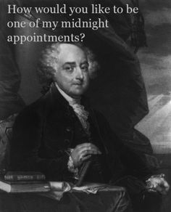
Midnight judges
Federalist judges appointed by John Adams between the time he lost the election of 1800 and the time he left office in March 1801.

Slide 23
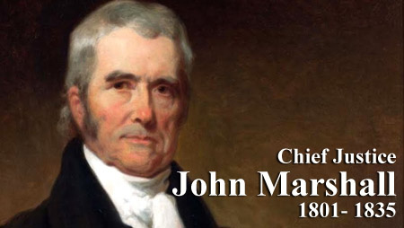
John Marshall
Appointed to the Supreme Court by John Adams in 1801, he served as chief justice until 1835.
His legal decisions gave the Supreme Court more power, strengthened the federal government and protected private property.

Slide 24
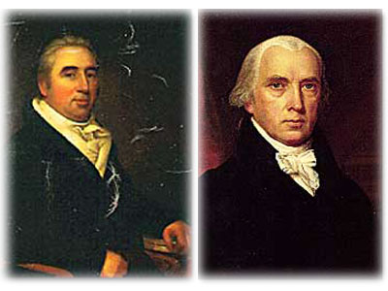
Marbury v. Madison, 1803
Supreme Court decision that declared a section of the Judiciary Act of 1789 unconstitutional and established the principle of judicial review.

Slide 25
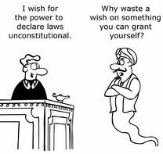
Judicial review
The power of the Supreme Court to review the constitutionality of laws passed by Congress.

Slide 26
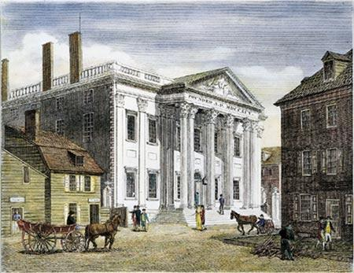
McCulloch v. Maryland, 1819
A Supreme Court decision that upheld the constitutionality of the Bank of the United States.
Referencing Maryland not having the right to tax the federal bank, John Marshall wrote, “The power to tax is the power to destroy.”!

Slide 27
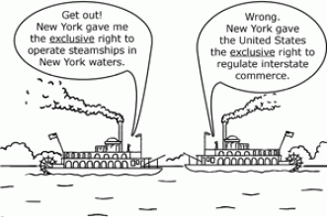
Gibbons v. Ogden, 1824
Supreme Court decision stating that the authority of Congress is absolute in matters of interstate commerce.

Slide 28
American Economic Development
With the acceleration of a national and international market economy, Americans debated the scope of government’s role in the economy, while diverging economic systems meant that regional political and economic loyalties often continued to overshadow national concerns.

Slide 29
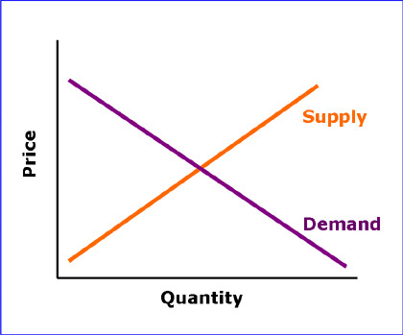
Market Economy
Economic system based on the unregulated buying and selling of goods and services.
Prices are determined by the forces of supply and demand.

Slide 30
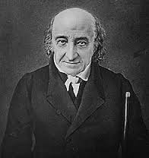
Albert Gallatin
Treasury secretary under Thomas Jefferson who favored limited government and reduced the federal debt by cutting spending.

Slide 31
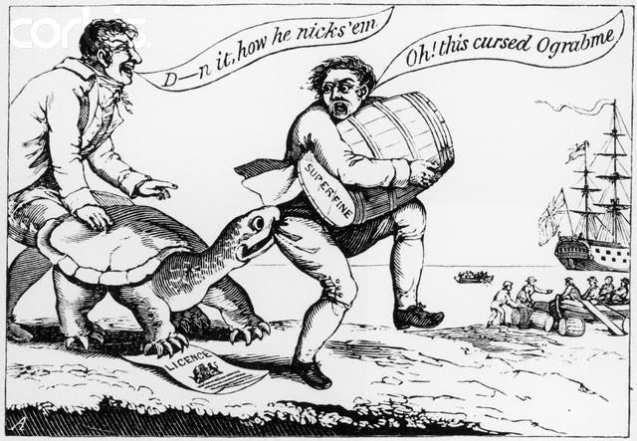
Embargo Act, 1807
In order to pressure Britain and France to accept neutral trading rights, Jefferson issued a government-ordered ban on international trade.
The Embargo went into effect in 1808 and closed down virtually all U.S. trade with foreign nations.

Slide 32
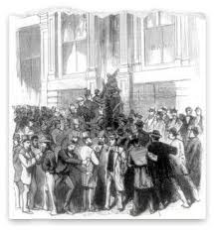
Panic of 1819
Financial panic that began when the Second Bank of the U.S. tightened credit and recalled government loans.

Slide 33
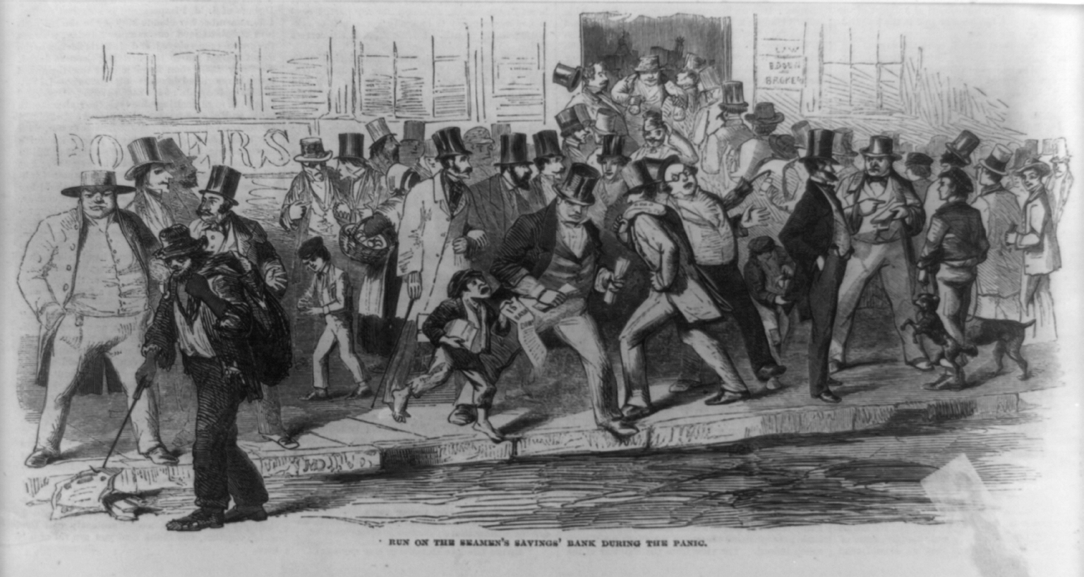
Panic of 1837
Economic collapse caused primarily by President Jackson’s destruction of the Second Bank of the United States.

Slide 34
Debates over the tariff and internal improvements
Northerners generally favored higher tariffs and internal improvement at federal expense.
Southerners generally opposed higher tariffs and internal improvements at federal expense.

Slide 35
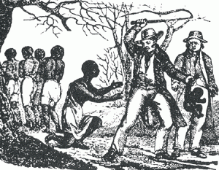
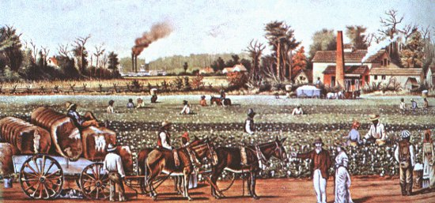
Southern Slavery
Many white Americans in the South asserted their regional identity through pride in the institution of slavery, insisting that the federal government should defend that institution.

Slide 36
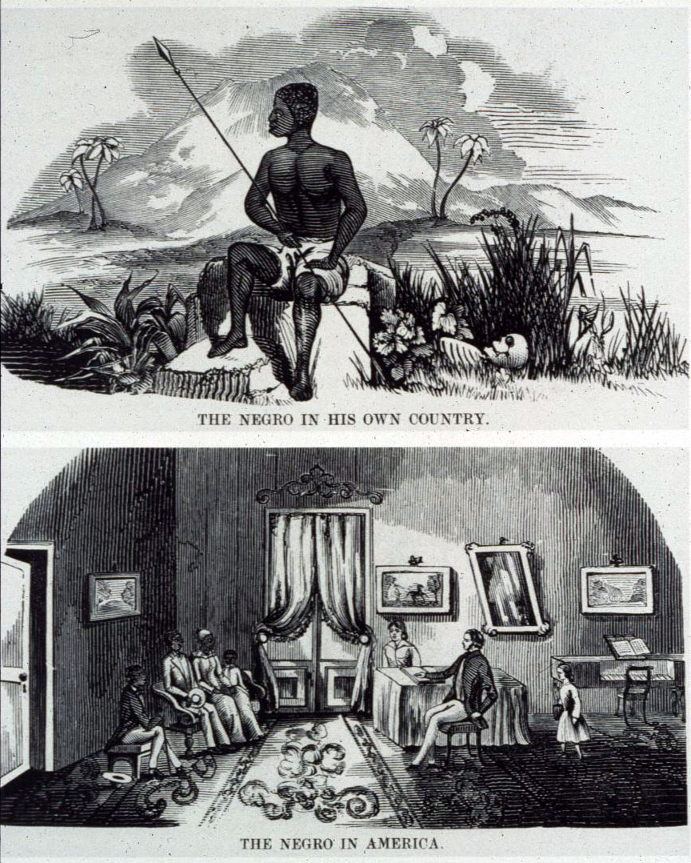
Southern defense of slavery
Southerners held a widespread belief that blacks were inferior to whites and that slavery was good for blacks.
Southerners also understood that the southern cotton economy was dependent on slave labor.

Slide 37
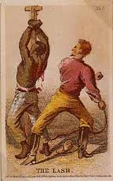
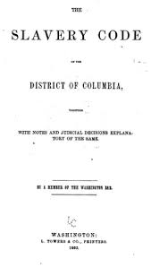
Slave codes
Laws that established the status of slaves denying them basic rights and classifying them as the property of slave owners.

Slide 38
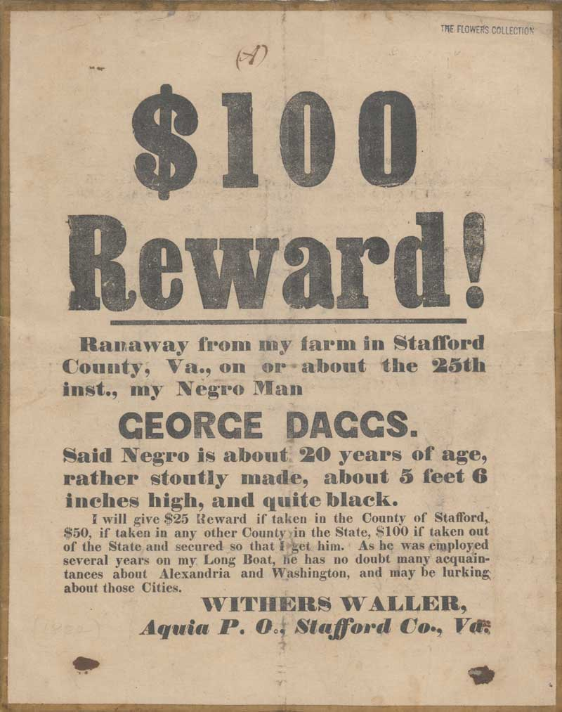

Slide 39
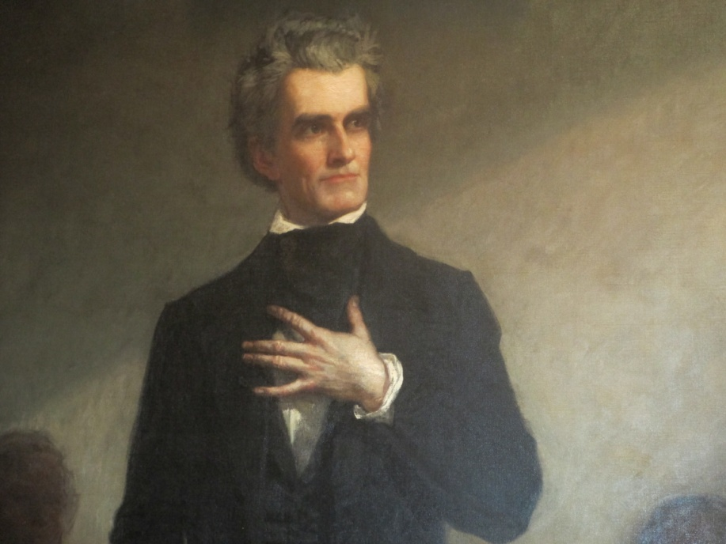
Calhoun’s Speech in the U.S. Senate, 1837
John C. Calhoun, a senator from South Carolina, outlined proslavery arguments on the floor of the U.S. Senate, arguing that the stability of societies throughout history had been based on slavery.

Slide 40
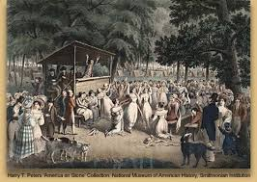
Second Great Awakening and American Reform Movements
The Second Great Awakening, liberal social ideas from abroad, and Romantic beliefs in human perfectibility fostered the rise of voluntary organizations to promote religious and secular reforms, including abolition and women’s rights

Slide 41
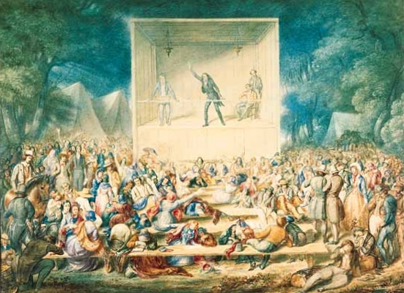
Second Great Awakening
An increase in religious activity that began around 1800 and was characterized by emotional revival meetings.
The Second Great Awakening led to several reform movements designed to make life better in this world.

Slide 42
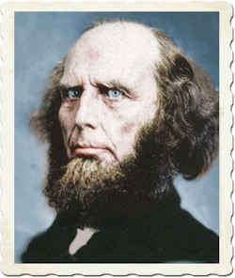
Charles Finney
Presbyterian minister who is credited with starting the Second Great Awakening and is known as the “Father of Modern Revivalism.”
Finney advocated the abolition of slavery and equal education for women and African Americans.

Slide 43
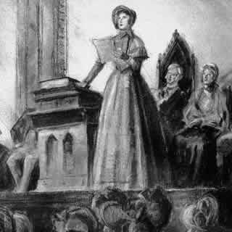
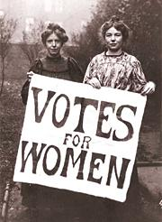
Seneca Falls Convention, 1848
The first convention in America for women’s rights.
Held in Seneca Falls, NY
Declaration of Sentiments

Slide 44
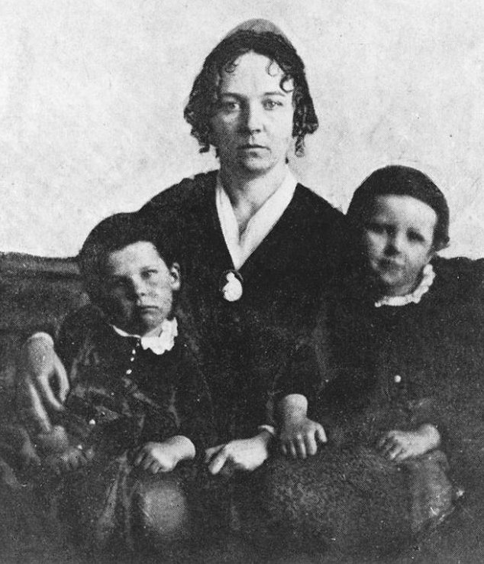
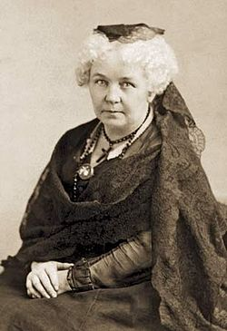
Elizabeth Cady Stanton
Advocate of women’s rights, including the right to vote, who organized (with Lucretia Mott) the first women’s rights convention at Seneca Falls, NY

Slide 45
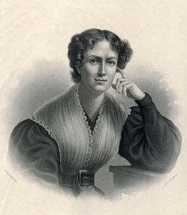
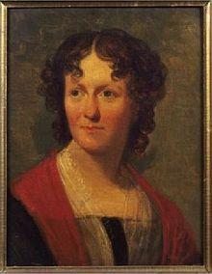
Frances (Fanny) Wright
Scottish-born woman who became a vocal advocate as a U.S. citizen for racial equality, equality for women, birth control, and open sexuality.

Slide 46
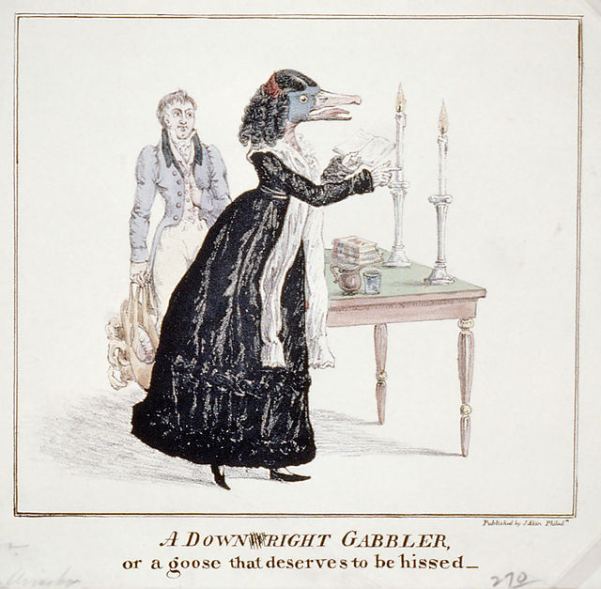

Slide 47
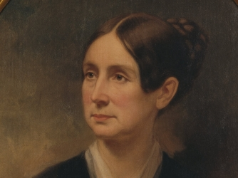
Dorthea Dix
Pioneer in the movement for special treatment for the mentally ill.

Slide 48
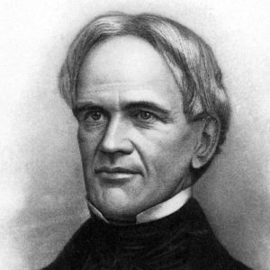
Harace Mann
Massachusetts educator who called for publicly funded education for all children.

Slide 49
Utopian Communities
Idealistic reform movement based on the belief that a perfect society could be created on Earth.
Significant Utopian experiments were established at New Harmony, Indiana, Brook Farm, Massachusetts, and Oneida Community in New York.

Slide 50
Abolition and the Rights of African Americans
Despite the outlawing of the international slave trade, the rise in the number of free African Americans in both the North and the South, and widespread discussion of various emancipation plans, the U.S. and many state governments continued to restrict African Americans’ citizenship possibilities.

Slide 51
James Forten
African American businessman from Philadelphia who advocated racial integration and equal rights during the Jeffersonian era.

Slide 52
American Colonization Society, 1817
Organization established to end slavery gradually by helping individual slave owners liberate their slaves and then transport the freed slaves to Africa.

Slide 53
William Lloyd Garrison
Radical abolitionist in Massachusetts who published The Liberator, an antislavery newspaper.

Slide 54
Sojourner Truth
Former slave (freed in 1827) who became a leading abolitionist and feminist.

Slide 55
Liberty Party, 1840
First antislavery political party in the United States.

Slide 56
Elijah Lovejoy
Abolitionist leader who was killed in Alton, Illinois, by a proslavery mob attacking his newspaper press to keep him from publishing.

Slide 57
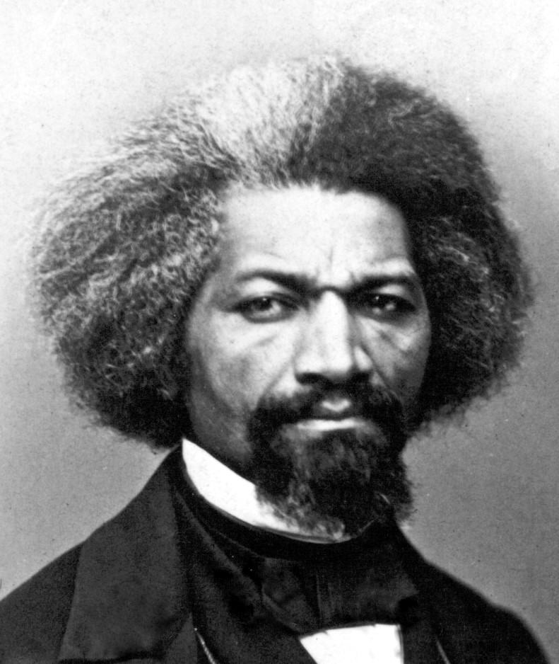
Frederick Douglass
Former slave who became a significant leader in the abolitionist movement. Known for his great oratorical skills.

Slide 58
Resistance to Reform
Resistance to initiatives for democracy and inclusion included proslavery arguments, rising xenophobia, anti-black sentiments in political and popular culture, and restrictive anti-Indian policies.

Slide 59
American Culture
A new national culture emerged, with various Americans creating art, architecture, and literature that combined European forms with local and regional cultural sensibilities.
Various groups of American Indians, women, and religious followers also developed cultures reflecting their interests and experiences, as did regional groups and an emerging urban middle class.

Slide 60
Neoclassicism
Revival in architecture and art in the late 1700s and early 1800s that was inspired by Greek and Roman models.

Slide 61
Hudson River School, 1825-1875
The first native school of painting in the U.S. Attracting artists who were rebelling against neoclassicism, Hudson River artists painted primarily landscapes.

Slide 62
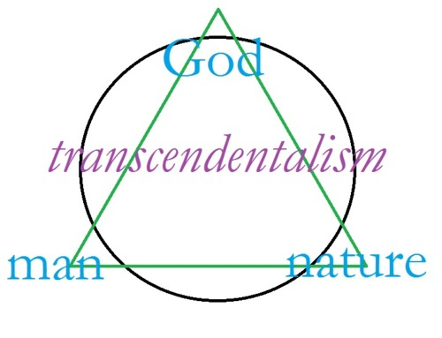
Transcendentalism
Philosophical and literary movement that believed God existed within human beings and nature. Transcendentalists believed intuition was the highest source of knowledge.

Slide 63
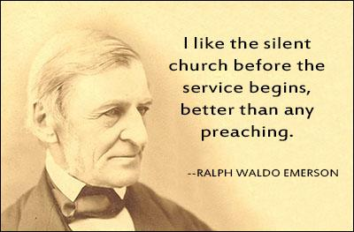
Ralph Waldo Emerson
Philosopher, writer, and poet who became a central figure in the American transcendentalist movement.

Slide 64
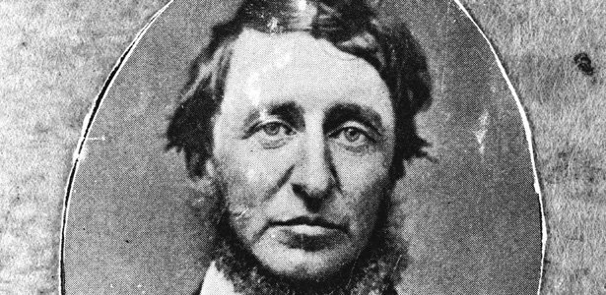
Henry David Thoreau
Writer and naturalist. With Ralph Waldo Emerson, he became America’s best known transcendentalist.

Slide 65
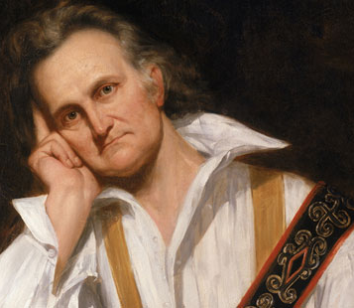
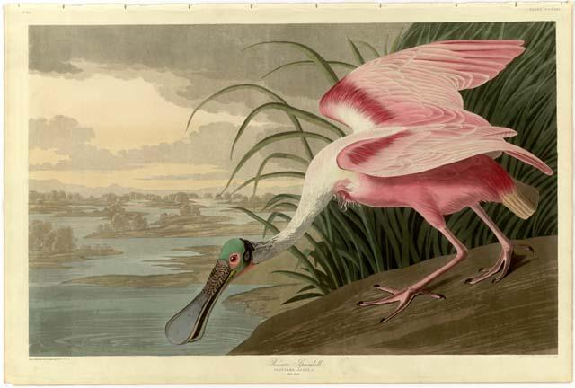
John James Audubon
Naturalist and painter who became well-known for his attempt to document all types of American birds.

Slide 66
African American Leadership and Culture
Enslaved and free African Americans, isolated at the bottom of the social hierarchy, created communities and strategies to protect their dignity and their family structures, even as some launched abolitionist and reform movements aimed at changing their status.

Slide 67
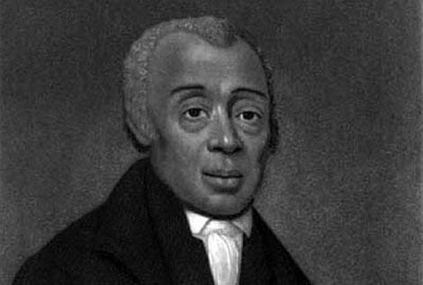
Richard Allen
African American minister who established the first independent African American denomination in the United States, the African Methodist Episcopalian Church.

Slide 68
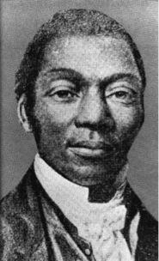
David Walker
African American who wanted slaves to rebel against their own masters. Walker relied on sailors and ship's officers sympathetic to the abolitionist cause to transfer his message to southern ports.

Slide 69
Slave Music
Music created by slaves for the purpose of religion, work, and recreation. Slave music became the foundation for later styles of music known as gospel, jazz, and blues.
https://www.youtube.com/watch?v=fjv0MYIFYsg

Slide 70
American Technological Developments
Innovations including textile machinery, steam engines, interchangeable parts, canals, railroads, and the telegraph, as well as agricultural inventions, both extended markets and brought efficiency to production for those markets.

Slide 71
Samuel Slater
Known as the “Father of the American Industrial Revolution,” Slater brought British textile technology to the United States.

Slide 72
Cyrus McCormick
Developed the mechanical reaper in 1831, a machine that revolutionized farming by increasing crops yields and decreasing the number of field hands needed for the harvest.

Slide 73
John Deere
Invented the steel plow in 1837, which revolutionized farming,
The steel plow broke up soil without the soil getting stuck to the plow (as happened with older wooden plows).

Slide 74
American Industry
Increasing numbers of Americans, especially women in factories and low-skilled male workers, no longer relied on semi-subsistence agriculture but made their livelihoods producing goods for distant markets, even as some urban entrepreneurs went into finance rather than manufacturing

Slide 75
Lowell System
A method of factory management that evolved in the textile mills of Lowell, Massachusetts, which were owned by the Boston Manufacturing Company and named after the company’s founder, Francis Lowell.
The Lowell system was the first example of a planned automated factory.

Slide 76
Baldwin Locomotive Works
A company located in Philadelphia, Pennsylvania, that built railroad locomotives.

Slide 77
Anthracite Coal Mining
Coal mines in Pennsylvania produced anthracite, which became the most popular fuel for heating homes in the northern United States until the 1950s when it was replaced by oil and gas burning heating systems.

Slide 78
Interchangeable Parts
Parts that were identical and which could be substituted for one another. Developed by Eli Whitney for the manufacturing of muskets.

Slide 79
Southern Cotton (The Cotton Belt)
Southern cotton furnished the raw material for manufacturing in the Northeast, while the growth in cotton production and trade promoted the development of national economic ties, shaped the international economy, and fueled the internal slave trade.

Slide 80
Development of a National Economy
Despite some governmental and private efforts to create a unified national economy, most notably the American System, the shift to market production linked the North and the Midwest more closely than either was linked to the South.

Slide 81
American System, 1815
Henry Clay’s proposal to make the U.S. economically self-sufficient. The American System called for protective tariffs, internal improvements at federal expense, and the creation of a Second Bank of the United States.

Slide 82
Development of Natural Resources
Efforts to exploit the nation’s natural resources led to government efforts to promote free and forced migration of various American peoples across the continent, as well as to competing ideas about defining and managing labor systems, geographical boundaries, and natural resources

Slide 83
Westward Migration
With the opening of canals and new roads into the western territories, native-born white citizens relocated westward, relying on new community systems to replace their old family and local relationships.

Slide 84
Erie Canal, 1817-1825
A 350-mile canal built by the state of New York that stretched from Buffalo to Albany. The canal revolutionized shipping in New York.

Slide 85
Turnpikes
A road in which tolls were collected at gates set up along the road.

Slide 86
National Road (Cumberland Road), 1811
First significant road built in the U.S. at the expense of the federal government.
The road stretched from the Potomac River to the Ohio River.

Slide 87
Baltimore and Ohio Railroad, 1828
First steam railroad commissioned in the U.S.

Slide 88
European Immigration
Migrants from Europe increased the population in the East and the Midwest, forging strong bonds of interdependence between the Northeast and the Old Northwest.

Slide 89
The Southern Identity
The South remained politically, culturally, and ideologically distinct from the other sections, while continuing to rely on its exports to Europe for economic growth

Slide 90
Mason-Dixon Line
The boundary between Pennsylvania and Maryland that marked the division between free and slave states before the Civil War.

Slide 91
American Society
The market revolution helped to widen a gap between rich and poor, shaped emerging middle and working classes, and caused an increasing separation between home and workplace, which led to dramatic transformations in gender and in family roles and expectations.

Slide 92
Cult of domesticity
The belief that a woman’s proper role in life was found in domestic pursuits (raising children, taking care of a home).

Slide 93
Lydia Maria Child
American writer who created novels and domestic manuals that attacked male dominance and white supremacy. She was also an abolitionist, Indian rights activist, and opponent of American expansionism.

Slide 94
National Trades’ Union, 1834
The first national association of trade unions.
(A trade union was a worker’s organization in which members worked in a specific trade or craft.)

Slide 95
Sectional Economic Differences
Regional interests continued to trump national concerns as the basis for many political leaders’ positions on economic issues including slavery, the national bank, tariffs, and internal improvements.

Slide 96
Second Bank of the United States, 1816
Privately-owned bank that operated as both a commercial bank and fiscal agent for the U.S. government.
The Second Bank of the U.S was established in 1816 under a charter that was supposed to last twenty years.

Slide 97
Tariff of 1816
The first protective tariff in U.S. history. The tariff was designed primarily to help America’s textile industry.

Slide 98
Tariff of Abominations, 1828
A tariff with such high rates that it set off tension between northerners and southerners over tariff issues.

Slide 99
Destruction of the Second Bank of the U.S. 1833
President Jackson, who thought the Bank of the U.S. represented special interests at the expense of the common man, ordered federal deposits placed in state banks (“pet” banks) to deplete the funds of the national bank.

Slide 100
John C. Calhoun
South Carolina political leader who defended slavery and advocated the doctrine of nullification, a policy in which a state could nullify federal law.

Slide 101
Daniel Webster
Massachusetts political leader who advocated a strong Union and thought the doctrine of nullification was a threat to the Union.

Slide 102
Henry Clay
Political leader from Kentucky and leading member of the Whig Party who worked to keep the Union together through compromise.

Slide 103
American Expansionism and Internationalism
Following the Louisiana Purchase, the drive to acquire, survey, and open up new lands and markets led Americans into numerous economic, diplomatic, and military initiatives in the Western Hemisphere and Asia. (4.3-IA) The U.S. sought dominance over the North American continent through a variety of means, including military actions, judicial decisions, and diplomatic efforts.

Slide 104
Louisiana Purchase, 1803
The U.S. purchased the Louisiana Territory from France for $15 million, doubling the size of the U.S. and giving the U.S. full control of the Mississippi River

Slide 105
Lewis and Clark Expedition, 1804-1806
Expedition to explore the Louisiana Territory led by Meriwether Lewis and William Clark

Slide 106
War Hawks
Members of Congress from the West and South elected in 1810 who wanted war with Britain in the hopes of annexing new territory and ending British trade with the Indians of the Northwest.

Slide 107
War of 1812, 1812-1815
War between the U.S. and Great Britain caused primarily by the British violation of American neutral rights on the high seas. The war ended with an agreement of “status quo ante” (a return to how things were before the war).

Slide 108
Adams-Onis Treaty, 1819
Treaty between the U.S. and Spain that ceded Florida to the U.S.

Slide 109
Monroe Doctrine, 1823
President Monroe’s unilateral declaration that the Americas would be be closed to further European colonization. The doctrine also stated the U.S. would not allow European interference in the affairs of the Western Hemisphere.

Slide 110
Webster-Ashburton Treaty, 1842
Treaty between the U.S. Great Britain that established the border between Canada and northeastern Maine.

Slide 111
Annexation of Texas, 1845
Through a joint resolution of Congress, the U.S. annexed and granted statehood to the Republic of Texas, an independent nation that had won its independence from Mexico in 1836.

Slide 112
Oregon Treaty, 1846
After years of conflict over ownership of the Pacific Northwest, the U.S. and England established the boundary at 49º latitude.

Slide 113
Manifest Destiny
Belief that the U.S. was destined to expand across the North American continent

Slide 114
Mexican American War, 1846-1848
War caused by a territorial dispute between the U.S. and Mexico that led to Mexico ceding land to the U.S.

Slide 115
Mexican Cession, 1848
The region of the present-day southwestern United States that Mexico ceded to the U.S. in the Treaty of Guadalupe Hidalgo.

Slide 116
Chinese Trade
In 1844 the U.S. secured a treaty with China that gave the United States the trading privileges already enjoyed by many other foreign powers.

Slide 117
Questions Raised by Territorial Expansion
With expanding borders came public debates about whether to expand and how to define and use the new territories. (Should the territories be designated “slave” or “free”? Should the territories be designated Indian territory?)

Slide 118
Federal vs. State Power
Federal government attempts to assert authority over the states brought resistance from state governments in the North and the South at different times

Slide 119
Hartford Convention, 1814
Meeting of Federalists during the War of 1812 in which anti-war Federalists threatened to secede from the Union. The convention was generally viewed by some as treasonous and the Federalist Party began to die out.

Slide 120
South Carolina Nullification Crisis, 1832-1833
After South Carolina declared a federal tariff null and void, President Jackson obtained a Force Bill to use military action against South Carolina. The crisis ended with a compromise to lower tariffs over an extended time.

Slide 121
Westward Expansion and American Indians.
Whites living on the frontier tended to champion expansion efforts, while resistance by American Indians led to a sequence of wars and federal efforts to control American Indian populations.

Slide 122
Tecumseh
Shawnee leader who established an Indian confederacy that he hoped would be a barrier to white expansion. Defeated at the Battle of Tippecanoe in 1811 by U.S. forces led by General William Henry Harrison.

Slide 123
Indian Removal Act, 1830
Law that provided for the removal of all Indian tribes east of the Mississippi and the purchase of Indian lands for resettlement.

Slide 124
Black Hawk
Sauk leader who brought his people back to their land in Illinois after their removal. Black Hawk was captured in 1832 after U.S. troops massacred his followers.

Slide 125
Worcester v. Georgia, 1832
A Supreme Court ruling that declared a state did not have the power to enforce laws on lands that were not under state jurisdiction, John Marshall wrote that the state of Georgia did not have the power to remove Indians.

Slide 126
Trail of Tears, 1838
Forced march of the Cherokee people from Georgia to Indian Territory in the winter of 1838. Thousands of Cherokees died.

Slide 127
Seminole Wars, 1814-1819, 1835-1842
The Seminole of Florida opposed removal and resisted U.S. troops.

Slide 128
Slavery in the Territories
The 1820 Missouri Compromise created a truce over the issue of slavery that gradually broke down as confrontations over slavery became increasingly bitter. As overcultivation depleted arable land in the Southeast, slaveholders relocated their agricultural enterprises to the new Southwest, increasing sectional tensions over the institution of slavery and sparking a broad-scale debate about how to set national goals, priorities, and strategies.

Slide 129
Talmadge Amendment, 1819
An amendment to a statehood bill for Missouri that would have banned slavery from Missouri. The amendment created a deadlock in Congress that led to the Missouri Compromise.

Slide 130
Missouri Compromise, 1820
Law proposed by Henry Clay admitting Missouri to the U.S. as a slave state and Maine as a free state. The law also banned slavery in the Louisiana Territory north of latitude 36º30′

Slide 131
Additional Information

Slide 132
American Anti-Slavery Society
Abolitionist society founded by William Lloyd Garrison. Included Frederick Douglass as a significant leader of the society.

Slide 133
Essex Junto
A group of Federalists originating in Essex County, Massachusetts, who opposed going to war against the British in the War of 1812.
Supported the Hartford Convention, which led to the demise of the Federalist Party

Slide 134
To what extent did economic sectionalism lead to the inevitability of the Civil War?

